Slide 1
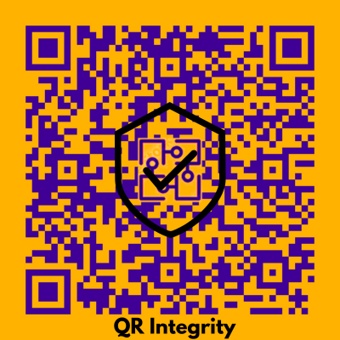
MAJOR PROJECT
Problem Statement Title: QR Integrity-Ensure Integrity Through Blockchain
Team Members:
2003481520023
2003481520008
2003481520017
2003481520001
Institute Name: PSIT COE
Theme Name: Blockchain

Slide 2
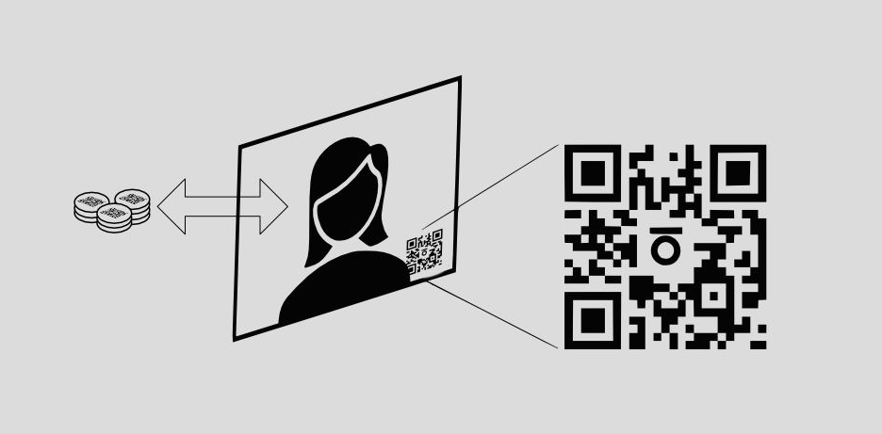
Overview

Slide 3
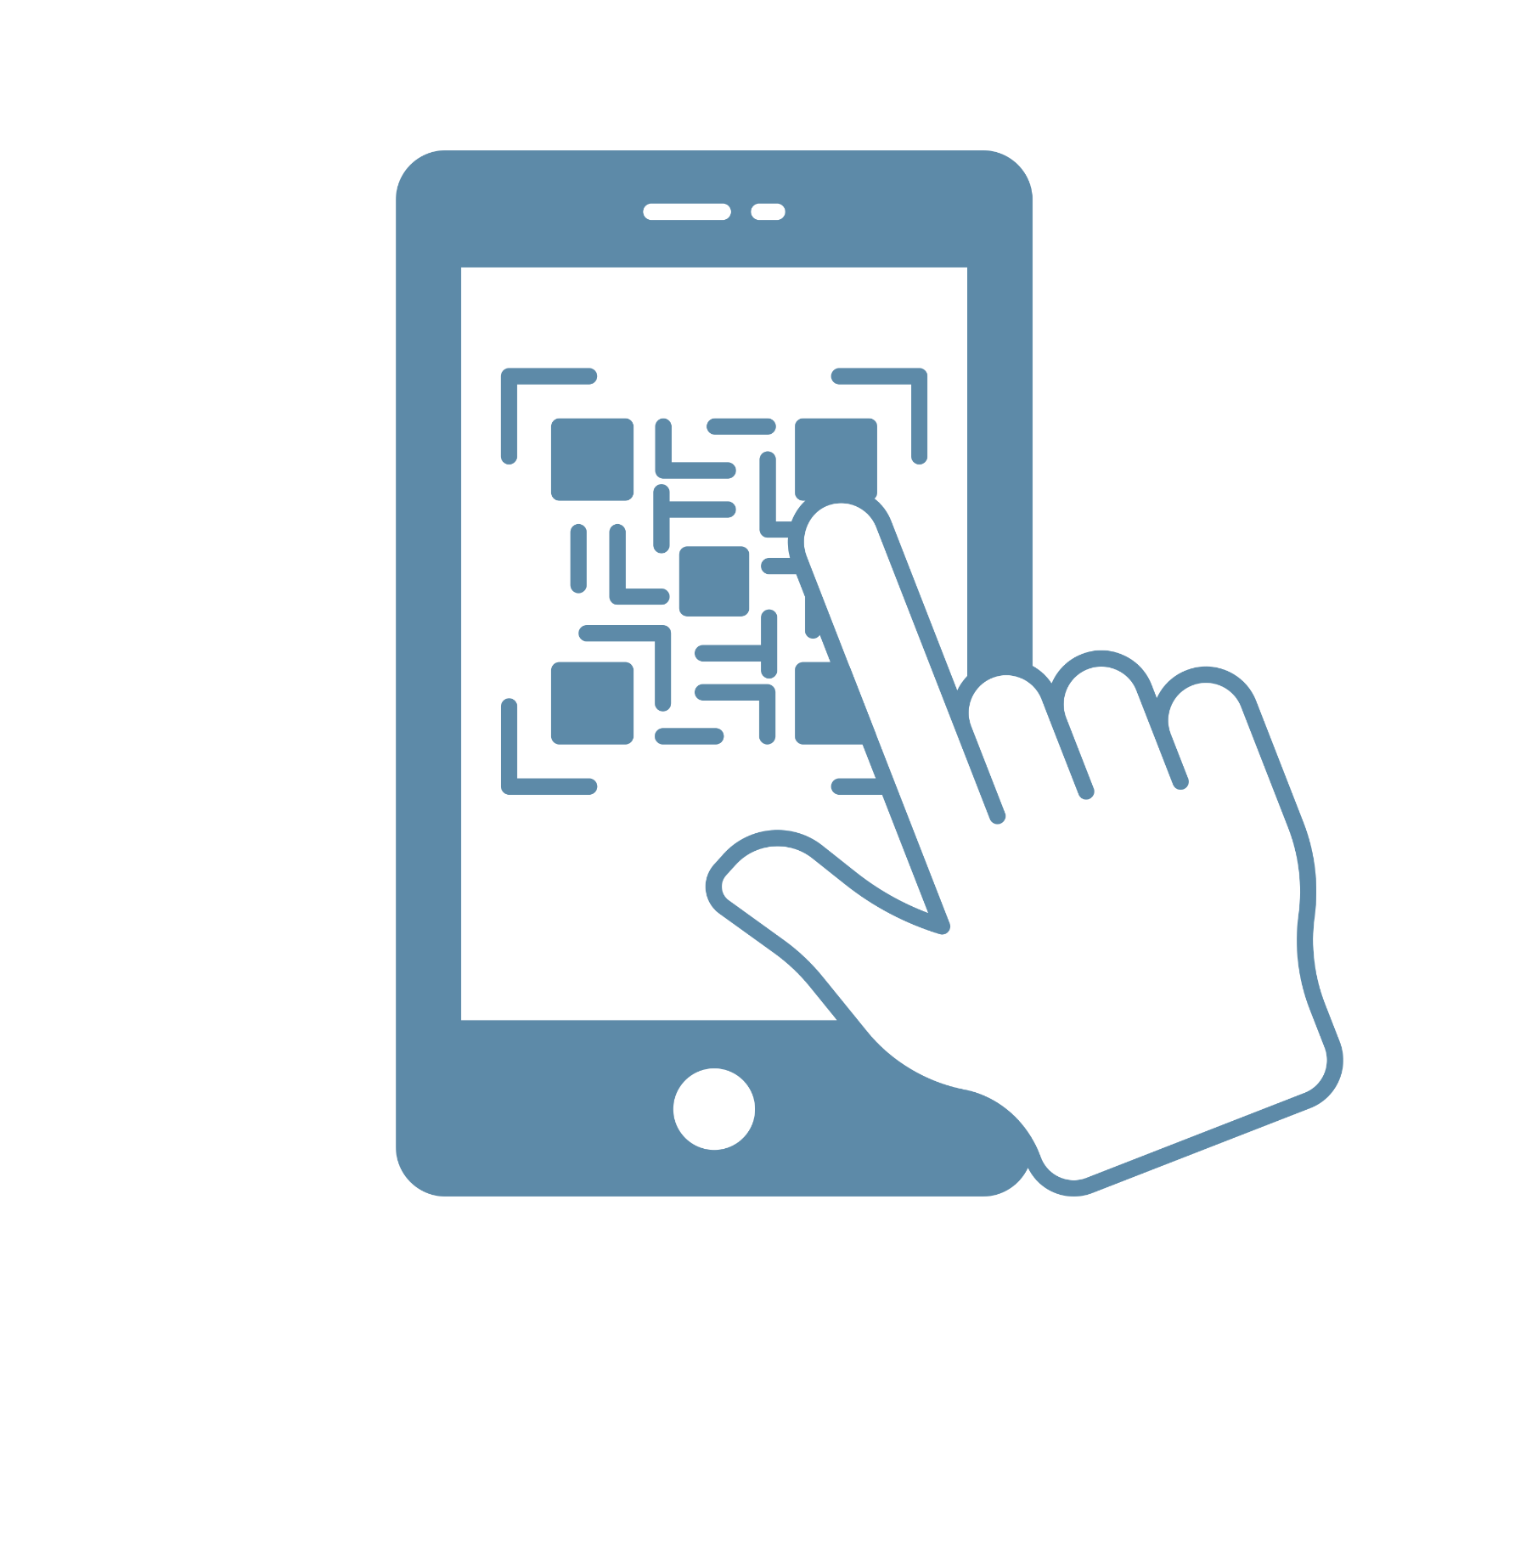
WHAT IS QR INTEGRITY?
In commerce, QR integrity deals with the problem of risk factors like forging and duplication frequently accompany the global enhancement of a product or innovation.
The main component of QR integrity include:
Authentication: Verifying the authenticity of the QR code and the device scanning it is crucial for maintaining integrity.
Secure QR Code Generation: Implement a secure method for generating QR codes associated with each product. Ensure that the generation process is not easily replicable or predictable by counterfeiters.
User-Friendly Interface: Design a user-friendly interface for consumers and other stakeholders to interact with the blockchain. This could be through a website, or other accessible platforms.

Slide 4
Problem Statement
Our Solution
Global product enhancement faces risks like forgery and duplication, impacting company reputation and customer well-being. Fake items pose a significant challenge, harming manufacturers. India combats counterfeits using a Blockchain-based QR code framework, ensuring secure identification of genuine products.
Innovative web app fights counterfeits with blockchain-based QR codes, ensuring product authenticity. Users scan QR codes, cross-referencing special codes with blockchain records to detect and avoid counterfeit goods efficiently.

Slide 5

Overview
Overview 1
A secure QR authentication system for goods industry.
Overview 2
Ensures authentication, secure storage, and secure QR code generation to avoid mutability.
Uses database for manufacturer’s login and register information.
Overview 3
User-friendly interface enabling user to scan and upload QR’s.
Overview 4

Slide 6
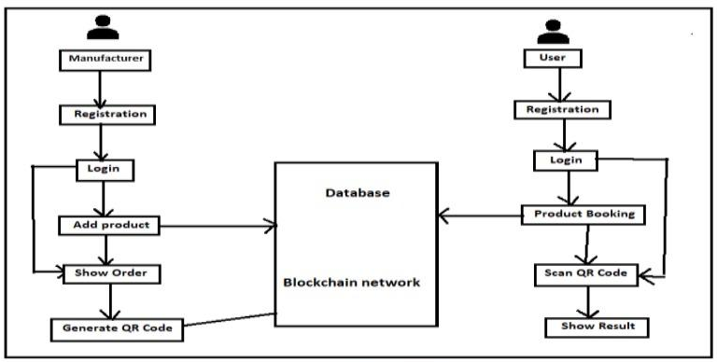
FLOW DIAGRAM

Slide 7

Objectives

Slide 8
Objectives
Secured QR authentication platform
QR Upload
Generation of QR Code
Develop a platform that facilitates user to create their authentic login information, and allows them to verify if the available product is authentic or not.
Has the feature that allows user to upload the QR directly to the application and to get result in snap of fingers.
Enable manufacturers to generate unique QR codes for each product added to the system. These QR codes will serve as a digital fingerprint for the products.

Slide 9

Implementation

Slide 10
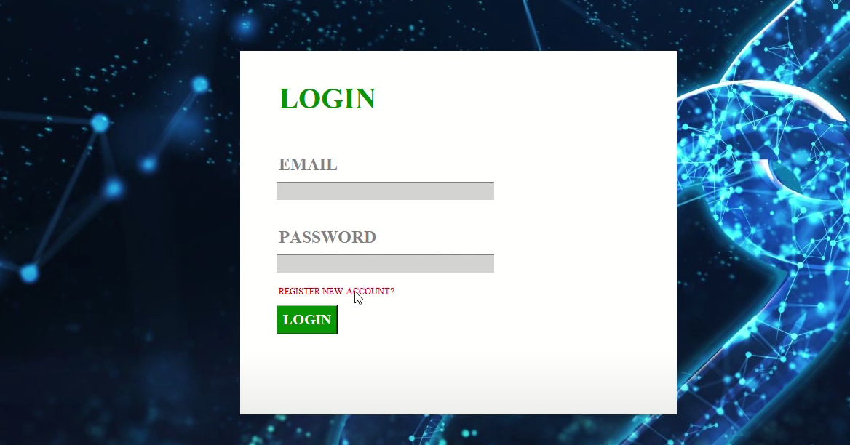
LOGIN PAGE

Slide 11
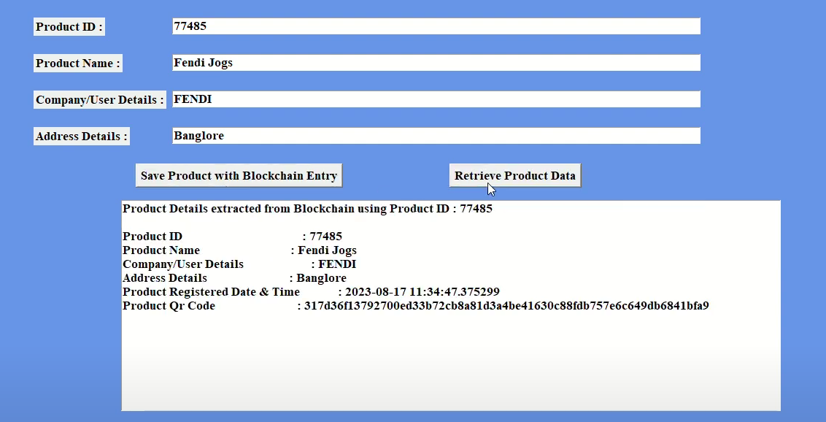
ADDITION OF PRODUCT’S INFO

Slide 12
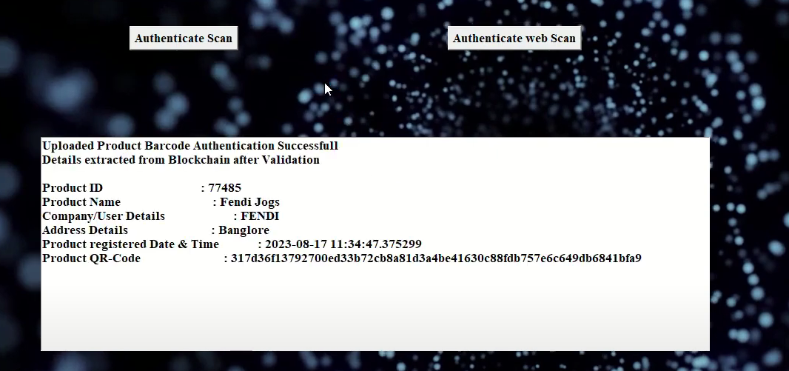
EXTRACTION OF INFO FROM QR

Slide 13
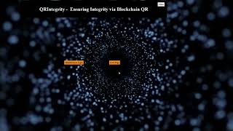
DEMONSTRATION VIDEO

Slide 14
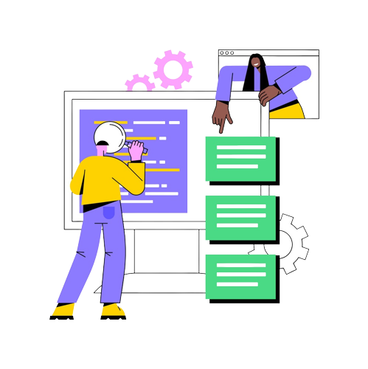
Requirements Description

Slide 15




Tech Stack
Frontend :
HTML5 : for creating web pages, forms for taking user input
CSS3 : for styling the web pages
Javascript : for adding dynamic behaviour in the application and handling of dom events like onclick and onsubmit.
VS Code : for integrated development environment.

Slide 16






Tech Stack
Backend :
Nodejs : for creating web servers .
Express js : for designing and development of rest api’s .
MySQL : Relational database for storing the customer, manufacturer and product details.
Axios : for making api calls .
JWT : for authentication of customer and manufacturer .

Slide 17




Tech Stack
Operating System: Windows 10 or Linux (Ubuntu 18.04 or higher)
Solidity: for writing the smart contracts on ethereum blockchain.
Ganache: for creating , testing and deployment on ethereum blockchain in our local environment .
IDE: Integrated Development Environment
RemixIDE.

Slide 18




Tech Stack
Deployment :
Docker : for containerization to maintain similar environment of development and deployment
Git : for version control
Github : for CI/CD (continuous integration / continuous development)
AWS : for hosting application, database.

Slide 19
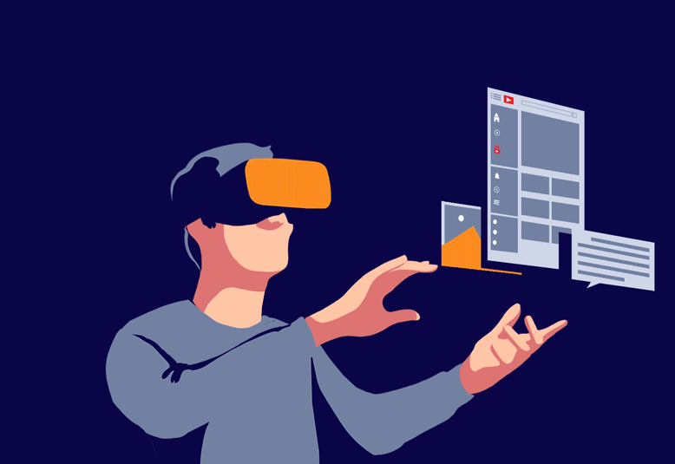
Future Enhancements

Slide 20

Future Enhancements
Android / IOS application : Mobile application complementing the web application.
Real Time QR Scan: Includes real-time scan for instant verification, ensuring swift and secure validation of product authenticity in every scan.

Slide 21
Thank you!
Do you have any questions?

